Slide 1
Create an ready-to-use module for visualizing attention weight and understand the visualization
Complete the detailed diagram of implementation

Slide 2
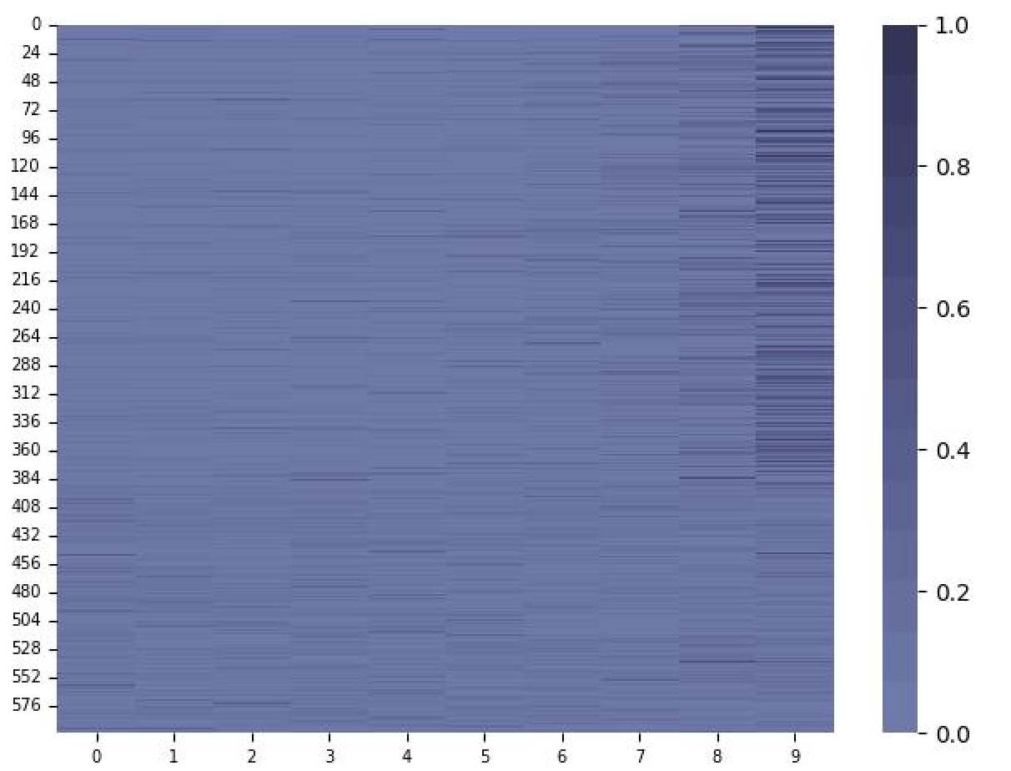
Visualizing attention weight
node
neighbour

Slide 3
TGN dataset preprocess implementation
train_mask = timestamps <= val_time & edge_not_contains_new_node_mask
Data(train_mask)
train_set
source
destination
new_node
Dataset
edge_idx
test_mask= timestamps > test_time
Data(test_mask)
val_mask= val_time < timestamps <= test_time
Data(val_mask)
timestamp
Random
sample
label
test_set
val_set
new_val_mask = val_mask & edge_contains_new_node_mask
Data(new_val_mask)
new_test_set
new_val_set

Slide 4
FedDC dataset preprocess implementation
clnt_data_list_cum_sum
trn_x
[0, 2, 4, …]
source
0 1 2 3 4 5
destination
client_x
Dataset
edge_idx
timestamp
client
trn_x[clnt_data_list_cum_sum[clnt_idx_]:clnt_data_list_cum_sum[clnt_idx_+1]]
label
client_x
[ np.zeros((clnt_data_list[clnt__], 5)).astype(np.float32) for clnt__ in range(self.n_client) ]

